Slide 1

Welcome

Slide 2
Minor Project Presentation On E-Learning Website
Submitted By :
Vidhan Sharma (2115990024)
Mayank Kumar Shrivastva (2115990010)
Shakya Vaibhav AjayaKumar (201500639)
Afzal Khan (201500043)
Submitted To :
Mr. Mayank Saxena
(Technical Trainer)
GLA University Mathura

Slide 3
Overview
Abstract
Introduction
Hardware Requirements:-
Tools and technology used
DFD of the project
Snapshots
Role of Member’s individually
Conclusion

Slide 4
Abstract
This project titled as “Smart Study Planner” comes under the Web Based Application. This application is developed with the help of HTML, CSS, Bootstrap, PHP, MySQL etc.

Slide 5
Introduction
The Smart Study Planner will be created using WAMP Stack for a smooth, fast, efficient and user-friendly software. The primary task of smart study planner is to help student to create their self- learning time table/planner with the best time managed schedule without any problem. User will able to select their own free time for flexible hours planning of their study planner, this feature will help user to optimize and boost the studies in their rest hours. This will help multiple domain people to create a very effective planner for their Day to day life. With all the basic and advance features of most of the apps and web of time management, to-do-list, reminders and other apps.

Slide 6
In this Smart Study Planner we are added a Six module that is..
Registration Module: Provides a registration form to the user to fill his/her details. And provides the user-"user-id" and "password" on successful completion of the registration.
Login Module: Validates the user-id and password (entered by the user) from the databases.
Planner Module : Provides the user different time-table options to choose from.
Profile Module: Enables the user to view his/her information.
Log-out Module: Provides the log-out facility to the user and admin.

Slide 7
Hardware Requirements:-
Microsoft Windows XP/7/8/10/11 (32-bit or 64-bit)
RAM 1 GB
Disk Space 2 GB of Available Hard Disk

Slide 8
Software Requirements :-
Operating System Windows 11
Front End HTML, CSS, JavaScript
Back End PHP
Library/ Framework Tailwind CSS, Bootstrap CSS
Code Editor Visual Studio Code, Notepad++
Database MySQL
Web Server Apache
Web Browser Google Chrome, Edge

Slide 9
Tools and technology used
Tools :-
Visual Studio :- A standalone source code editor that runs on Windows, macOS, and Linux. The top pick for JavaScript and web developers, with extensions to support just about any programming language
XAMPP is an abbreviation for cross-platform, Apache, MySQL, PHP and Perl, and it allows you to build WordPress site offline, on a local web server on your computer. This simple and lightweight solution works on Windows, Linux, and Mac – hence the “cross-platform” part. version is 7.3.25.
SQL: - SQL is a structured query language used for querying database.
HTML: - It is used for giving eye catching look to the website. And also providing easy to use GUI.

Slide 10
Tools and technology used
PHP stands for Hypertext Preprocessor PHP is a language used to develop interactive and dynamic content on the web and it is often used together with the Apache web server version is 6.0.
CSS: - CSS is cascading style sheet which is used to give designer look to HTML using the external file.
Bootstrap: -Bootstrap is a free and open-source CSS framework directed at responsive, mobile-first front-end web development. It contains HTML, CSS and JavaScript-based design templates for typography, forms, buttons, navigation, and other interface components
Tailwind :- Tailwind CSS is an open source CSS framework. The main feature of this library is that, unlike other CSS frameworks like Bootstrap, it does not provide a series of predefined classes for elements such as buttons or tables.

Slide 11
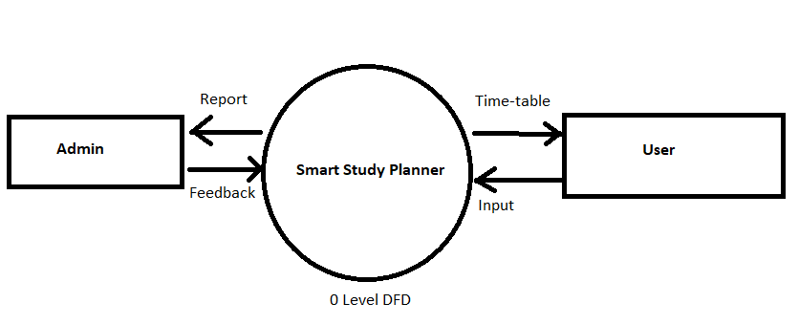
DFD of project

Slide 12
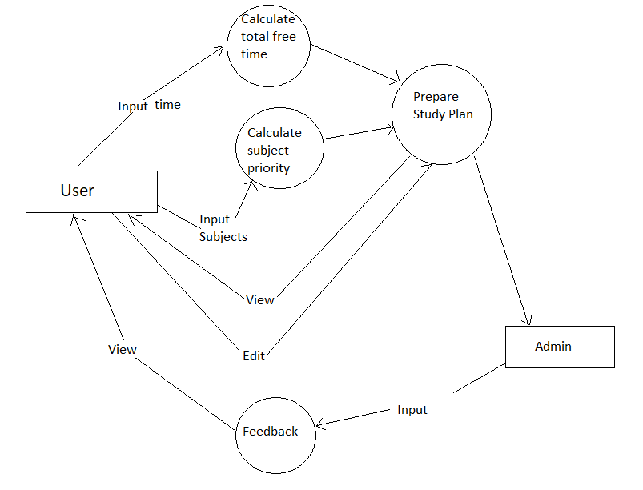
DFD of project

Slide 13
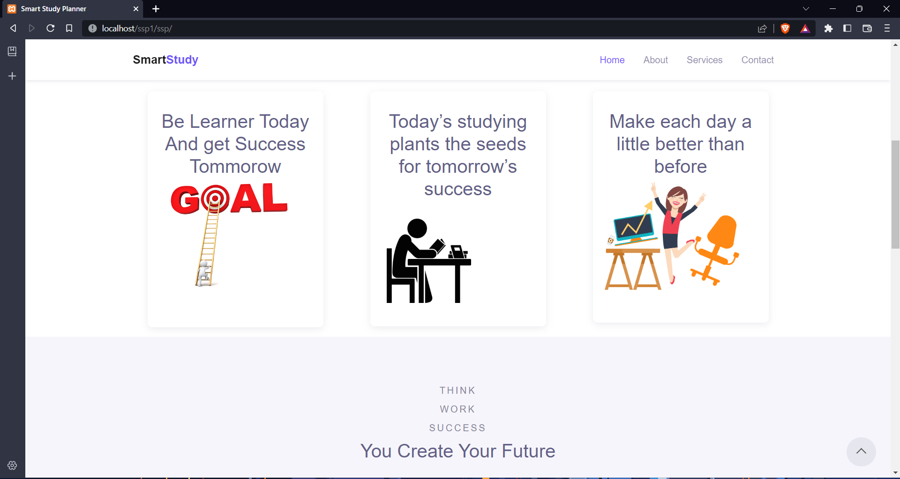
Front page of our website

Slide 14
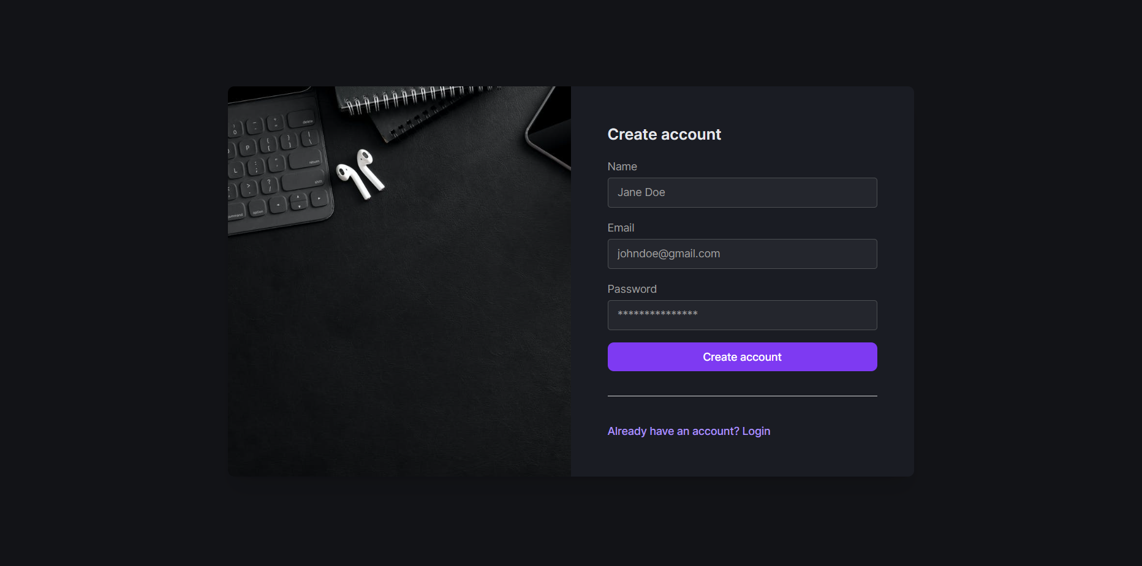
Sign up page

Slide 15
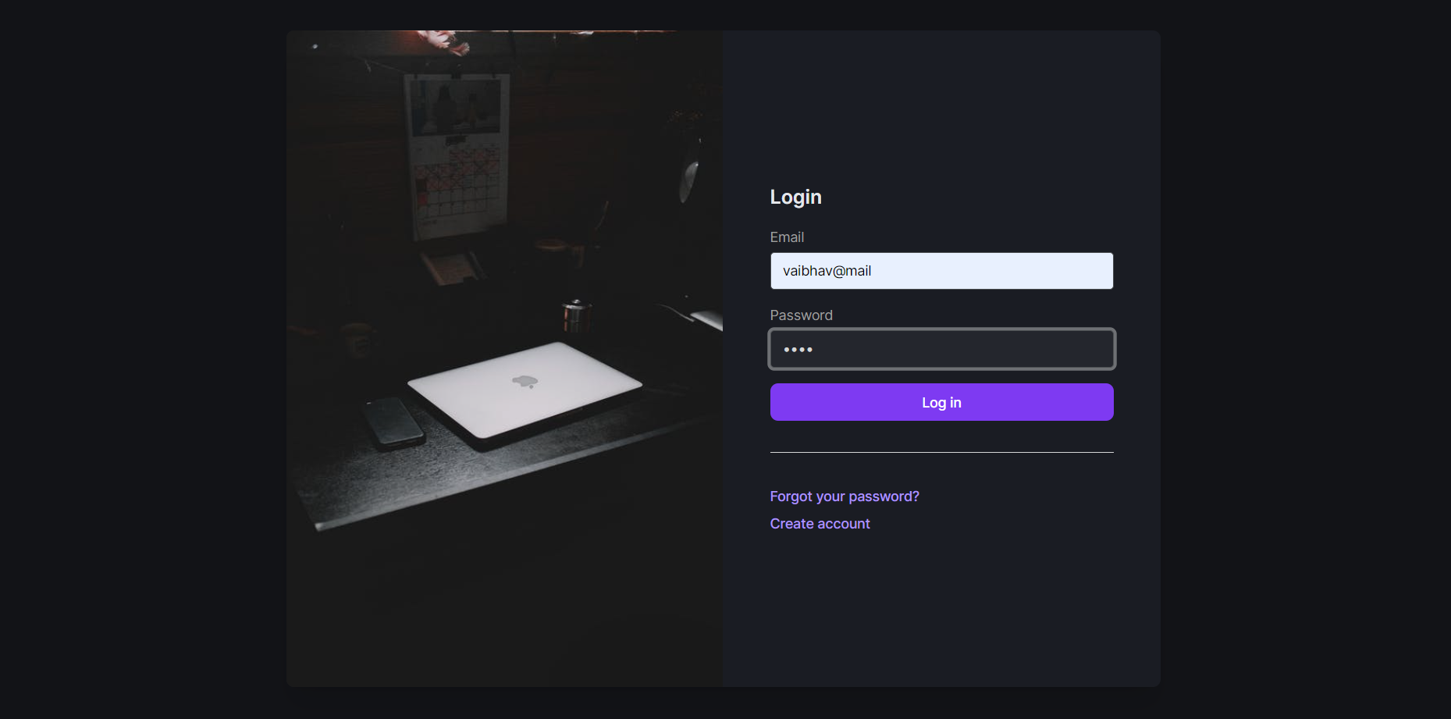
Login page

Slide 16
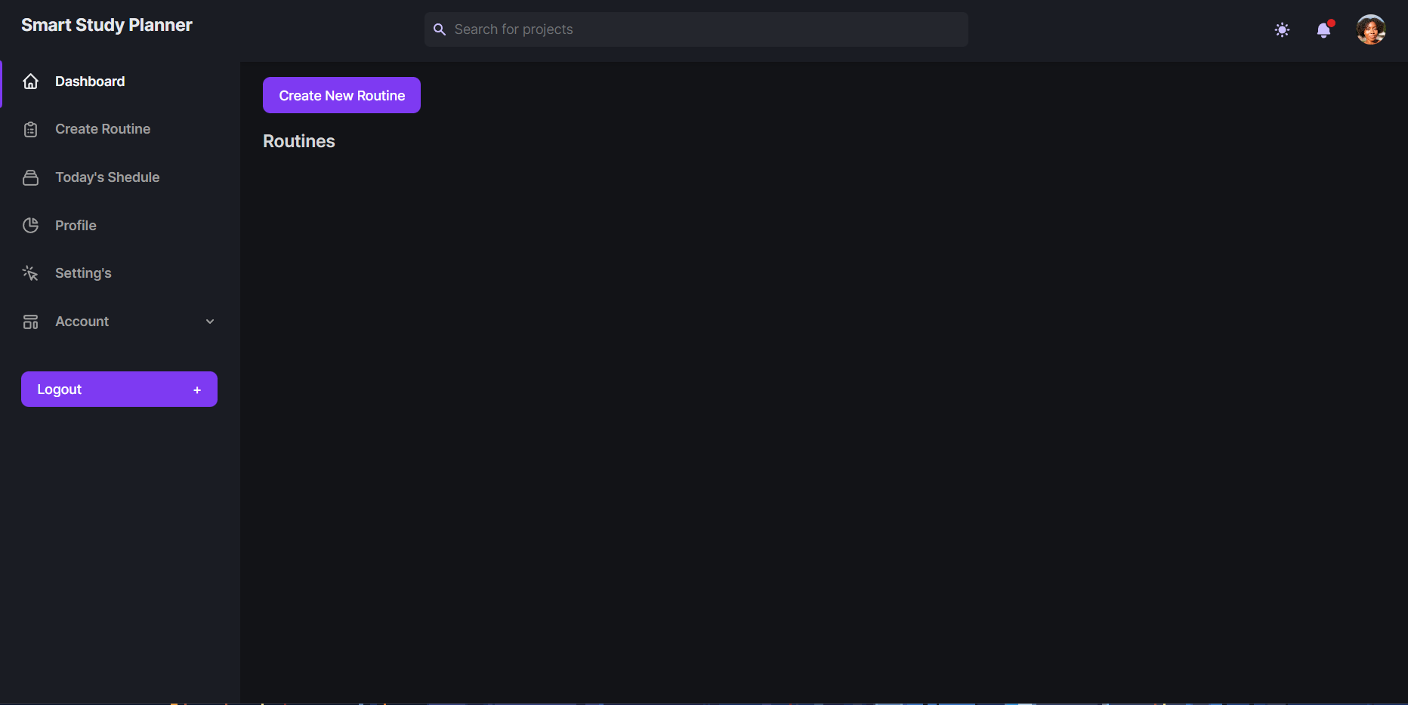
Routine Creation

Slide 17
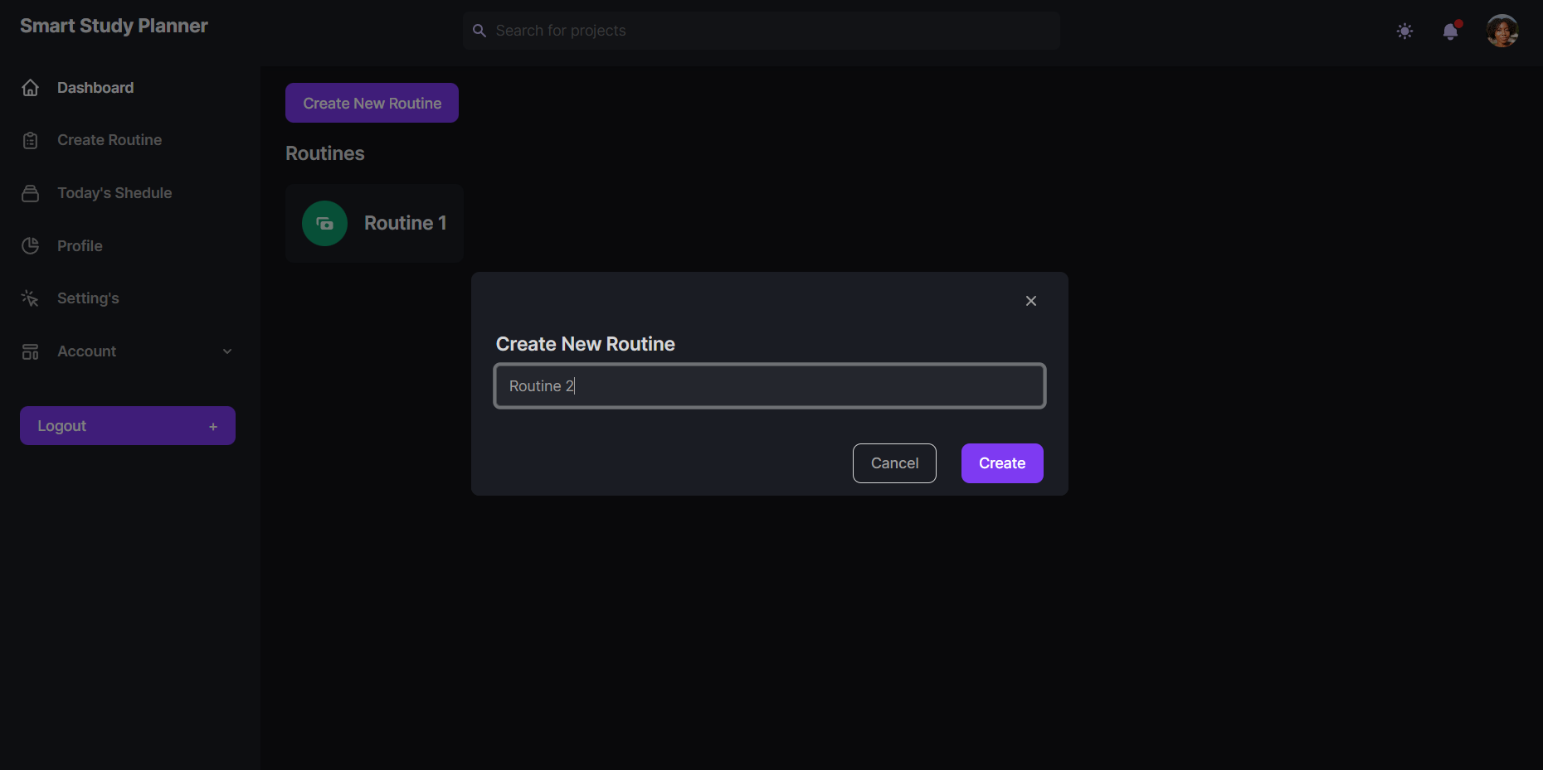
Multiple routines

Slide 18
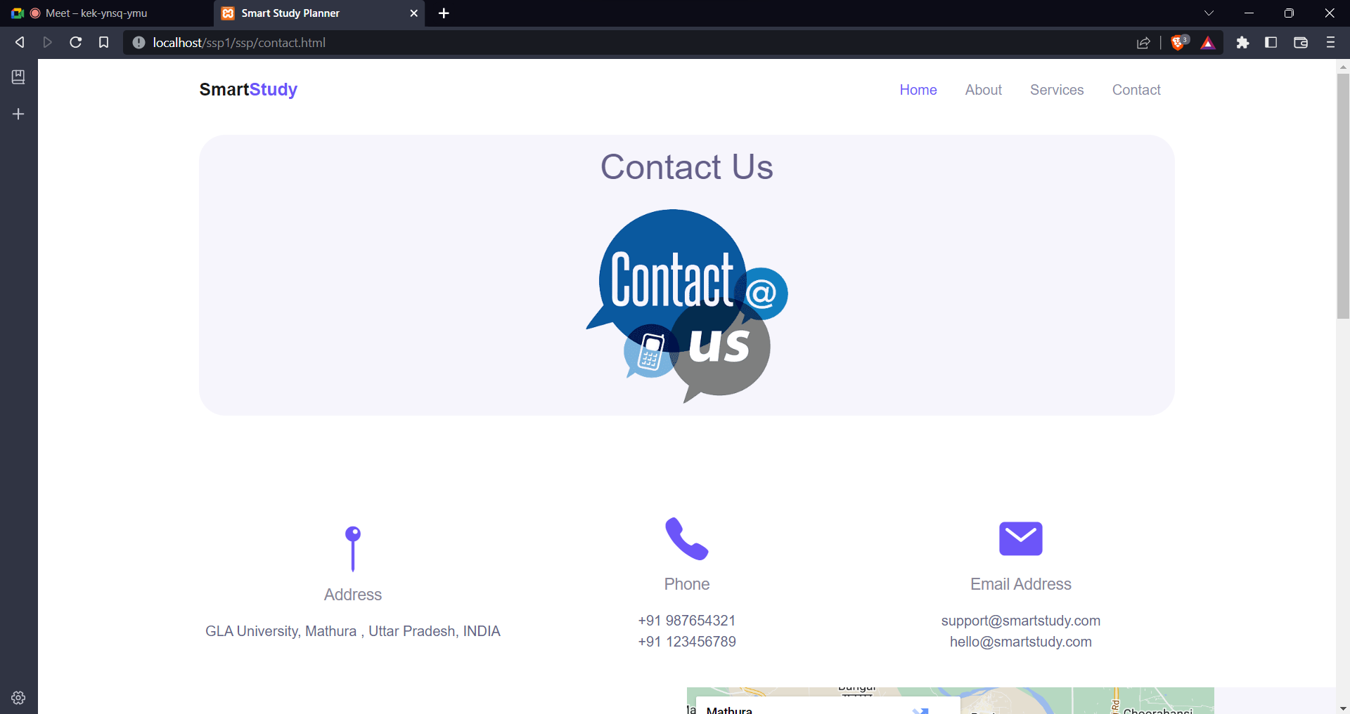
Contact us

Slide 19
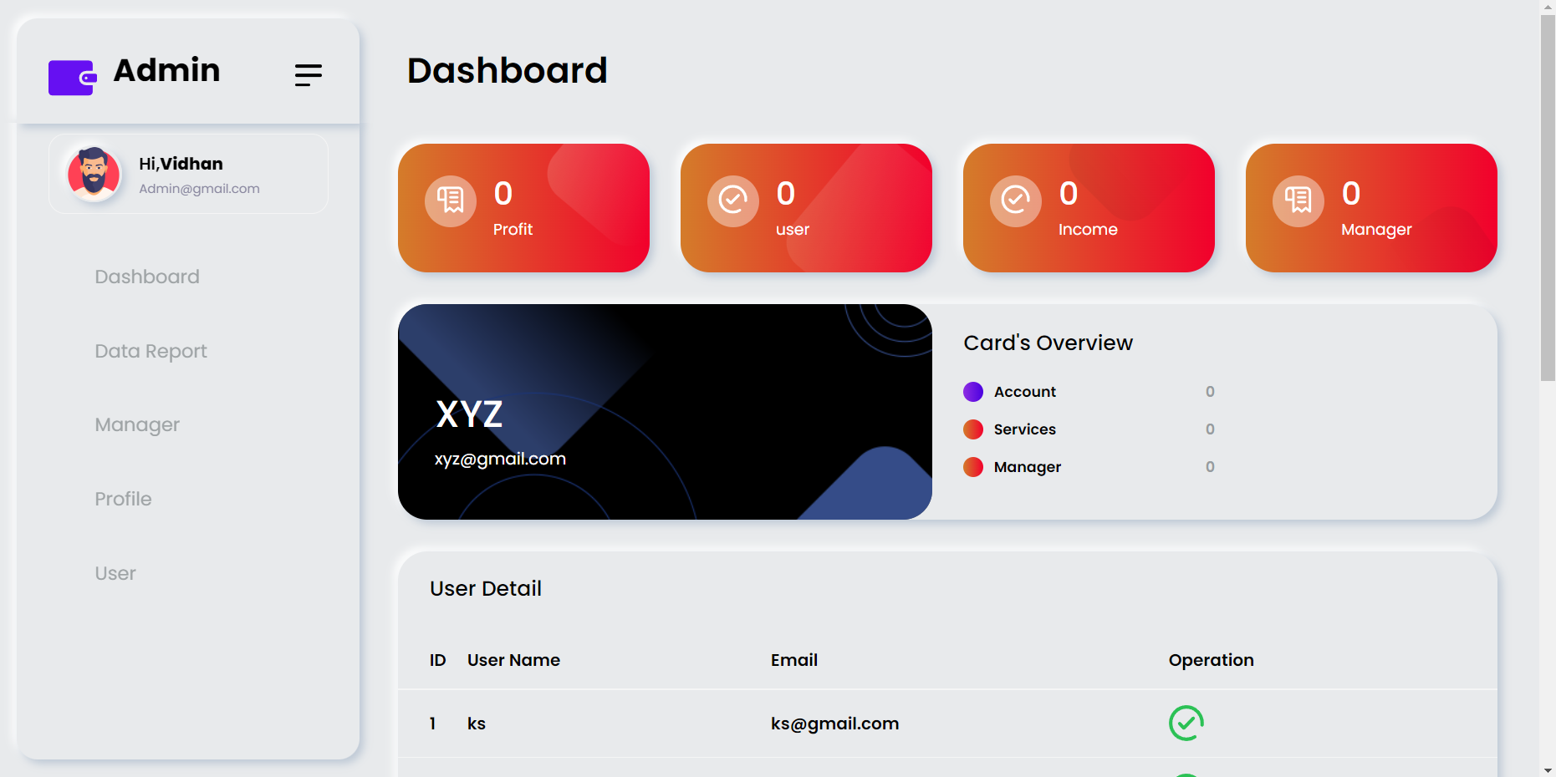
Admin Panel

Slide 20
Role :-

Slide 21
Conclusion :-
The Smart Study Planner has been computed successfully and was also tested successfully by taking "Test Cases". It is user friendly, and has required options, which can be utilized by the user to perform the desired operations. The Software is developed using HTML, CSS, JS as front-end and PHP, MySqli as back-end in windows environment.

Slide 22
Thank You…

